Slide 1
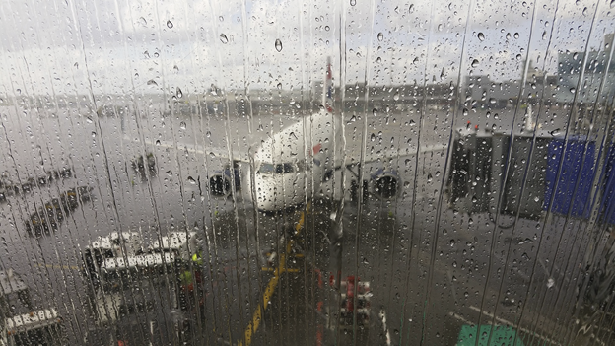


Flight Research & Analytics Group
Annie Chan
Azucena Faus
Mohammad Mahmoudighaznavi

Slide 2
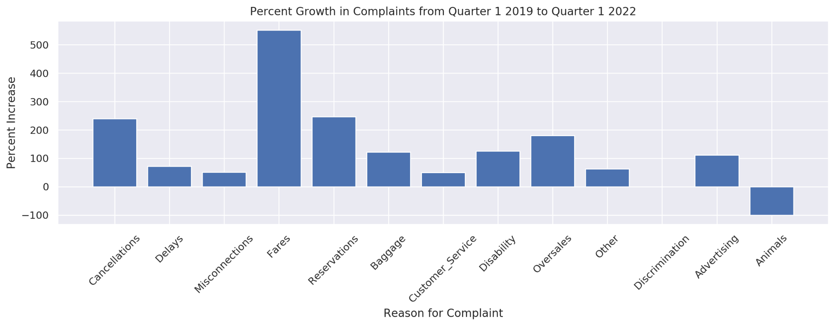
Customer satisfaction is at an all-time low - rates of complaints sent to the Department of Transportation are on the rise
Business Problem
Notes:
Total number of complaints sent to the Department of Transportation (not the airlines, mind you) - totaled 13,026 for Q1 2022 versus 3,000 for Q1 2019. The breakdown of complaints with top proportional growth in complaints being Fares, Reservations, Cancellations, and Oversales respectively

Slide 3
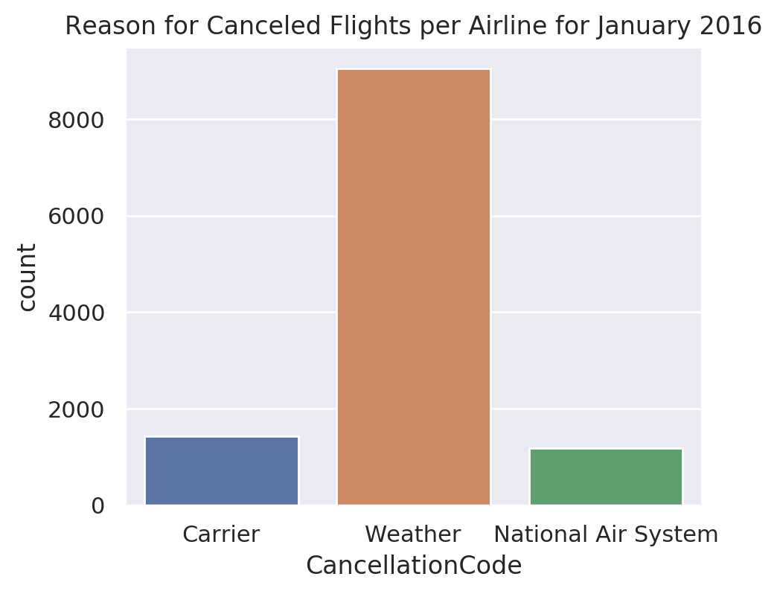
Most flight cancellations are due to weather conditions
Insights
Insights
Notes:
We would like to improve customer satisfaction and even though the problem is multi-faceted (Fares and Reservations are still the top complaint reasons from customers), cancellations are still at the top 3 and fares complaints are also often coupled with cancellations since sometimes you don’t get a refund for a cancellation when you are in a gray area such as a connected flight is canceled from another airline - so you still had to pay the other flights even though in the end, you could not go on your trip. Therefore, it appears looking into flight cancellations and the reason for those cancellations can help point us in the right direction. As we can see here, the overwhelming reason for flight cancellations in our data for all flights in the US was due to weather conditions. This matches current statistics for canceled flights in the continental US.

Slide 4
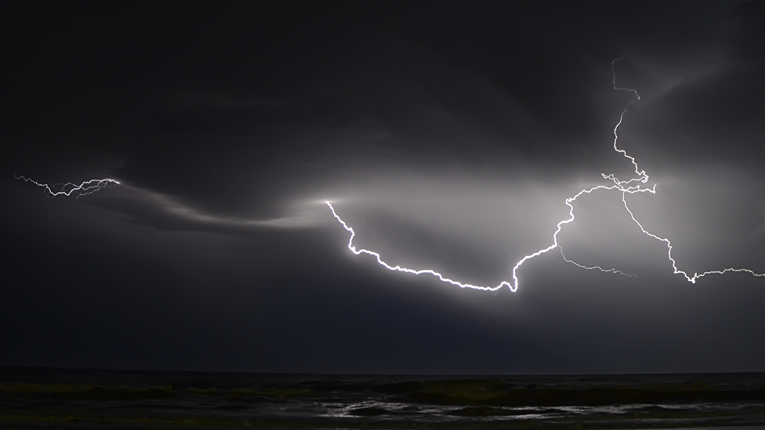




Develop an algorithm that predicts the likelihood of flight cancellations for JFK airport, using known weather conditions for those flights.
Our Solution
Notes:
We decided to start small - with one airport for one month (January 2016) which is notorious for canceled flights as a busy airport and with harsh weather conditions - we used an engineered feature that took into account both weather type and severity, snow depth, first snow, precipitation and average temperature for that day and assigned these to flights departing from JFK. We then developed a model that can predict a canceled flight based on weather information for that day.

Slide 5



Using AWS Automatic Tools vs Manual Coding
Results
Notes:
(We made use of amazon web services tools to automate model development and then used a simple explainable algorithm as our final solution since cost and latency are at a minimum this way…)Add in the metrics of accuracy and ability to predict the minority class without getting too technical. A chart/plot would work best and way better than a table. Explain this chart and what it says about the model and the accuracy - show how the rate of correctly predicting canceled flights is high.

Slide 6

Use this model as a foundation for a tool that will help predict flight cancellations due to weather for customers and airlines in the short term
Results
Notes:
Add in the metrics of accuracy and ability to predict the minority class without getting too technical. A chart/plot would work best and way better than a table. Explain this chart and what it says about the model and the accuracy

Slide 7

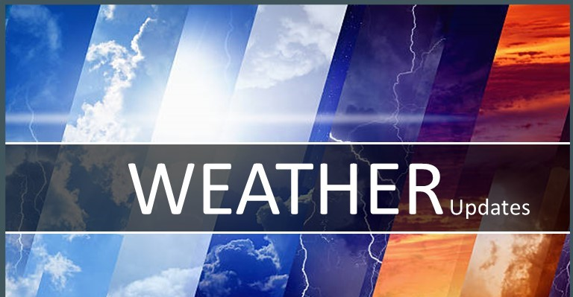
Gather live data - forecasted weather data to produce actionable outputs to help airlines plan in advance and make accurate decisions faster.
Next Steps
Notes:
Call to action -
Thank you, Mohammed. I am Annie and I will be the next to present. Next, we will discuss what is the next best action to take in order to produce actionable output. At the current stage, we used information on different flights and historical weather observations to train the model. While at deployment, we aim to use live data, which is forecasted weather data, in the production environment. That will allow our model to generate more insights ahead of time. For example, if weather forecasts assumed that there would be a heavy storm in four days, this piece of information would then be fed to the model and possibly returned a prediction of flights being cancelled in four days. Thus, more data on forecasted weather data should be gathered before deployment to retrain and improve the model. Ultimately, the model will be able to help airlines plan in advance how to adapt to severe weather conditions and make accurate decisions faster.

Slide 8

Utilizing prediction results to lower fares for certain flights and inform customers at time of booking to reduce dissatisfaction from fares, reservation and cancellation issues.
Long Term Recommendations
Notes:
Long Term Recommendations –
Lastly, we will look into what the long-term goals are and what we recommend the model to achieve in the long-term. The goal is to develop a finely tuned predictor function that can predict the likelihood of cancelled flights based on weather.
In the short term, airline operation and management can react quickly and decide on recovery solutions based on the model outputs. It can then help airlines minimize disruption costs such as passenger compensation and reduced revenue.
While in the long term, airlines can utilize the results and lower the costs for flights that are predicted to have higher probability of disruptions. Of course, customers will be informed at the time of booking by the system so that they can make necessary arrangements based on the purpose of their travel. This will not only serve as an encouragement for customers to take advantage of cheaper airfares, but also prepare them better in case of a flight disruption, thus enhancing the overall customer experience. Ideally, this will help mitigate the top three customers complaints that we mentioned earlier regarding airfares, reservation and cancellation issues.
Ultimately, airlines will be able to offer their passengers improved traveler experience and customer services, resulting in increased customer loyalty and profitability. Last by not least, we hope everyone can consider the opportunities that can be brought by this project.

Slide 9
References:
Fountain, T. (2016, January 21). Airlines waive fees to change flights leading up to snow storm. Fox61 News. https://www.fox61.com/article/travel/bucket-list/airlines-waive-fees-to-change-flights-leading-up-to-snow-storm/520-5097a9e4-071d-49e6-8d0b-242dd7efdd6f
Fregly, C. & Barth, A. (2021). Data Science on AWS Implementing End-to-End, Continuous AI and Machine Learning Pipelines. O'Reilly.
Jacobsen, P. (2022, June 9). Consumer Complaints Are Up 300% at Airlines. What’s Going On? FEE Stories. https://fee.org/articles/consumer-complaints-are-up-300-at-airlines-what-s-going-on/
Kaggle. (2020). [US Weather Events (2016 - 2021)] [WeatherEvents_Jan2016-Dec2021.csv]. https://relational.fit.cvut.cz/dataset/Airline
Moosavi, S. (2019, July 25). Short and Long-term Pattern Discovery Over Large-Scale Geo-Spatiotemporal Data. ACM Digital Library. https://dl.acm.org/doi/10.1145/3292500.3330755
NOWData NOAA Online Weather Data. National Weather Service. https://www.weather.gov/wrh/Climate?wfo=okx
Relational Dataset Repository. [airline][U.S. Department of Transportation (DOT), Bureau of Transportation Statistics (BTS)]. https://www.kaggle.com/datasets/sobhanmoosavi/us-weather-event
Notes:
And again thank you everyone for your time and here are some references.

